Slide 1
Pipeline Hazard Detection Simulator
CS 4200 – Computer Architecture
Jessica Webb

Slide 2
Topic Overview
What Does It Simulate?
Why Does It Matter?
5 Stage RISC-V Pipeline: IF, ID, EX, MEM, WB
RAW (Read-After-Write) data hazards between instructions
Stall insertion
Freezes IF/ID, inserts NOP bubble into EX
Cycle-by-cycle pipeline table output
Hazards cause the CPU to waste cycles, increasing CPI
Shows how dependent instructions impact real performance
Demonstrates the cost of forwarding not being interpreted
Compares hazard-free vs. hazard heavy programs

Slide 3
Code Structure
Instruction Class
parse() method
Parse each line of RISC-V assembly
Identifies opcode, dest register (rd), and source registers
Supports R-type, I-type, load, store, branch
has_raw_hazard()
Hazard Detection
Checks ID-stage instruction against EX and MEM stages
Flags if a source register matches a dest still in flight
Skips x0 (never a real hazard)
run_pipeline
Simulation Engine
Advances instructions through 5 pipeline register each cycle
On hazard: freezes IF/ID, inserts NOP into EX
Tracks cycles, stalls, CPI, and full timeline

Slide 4
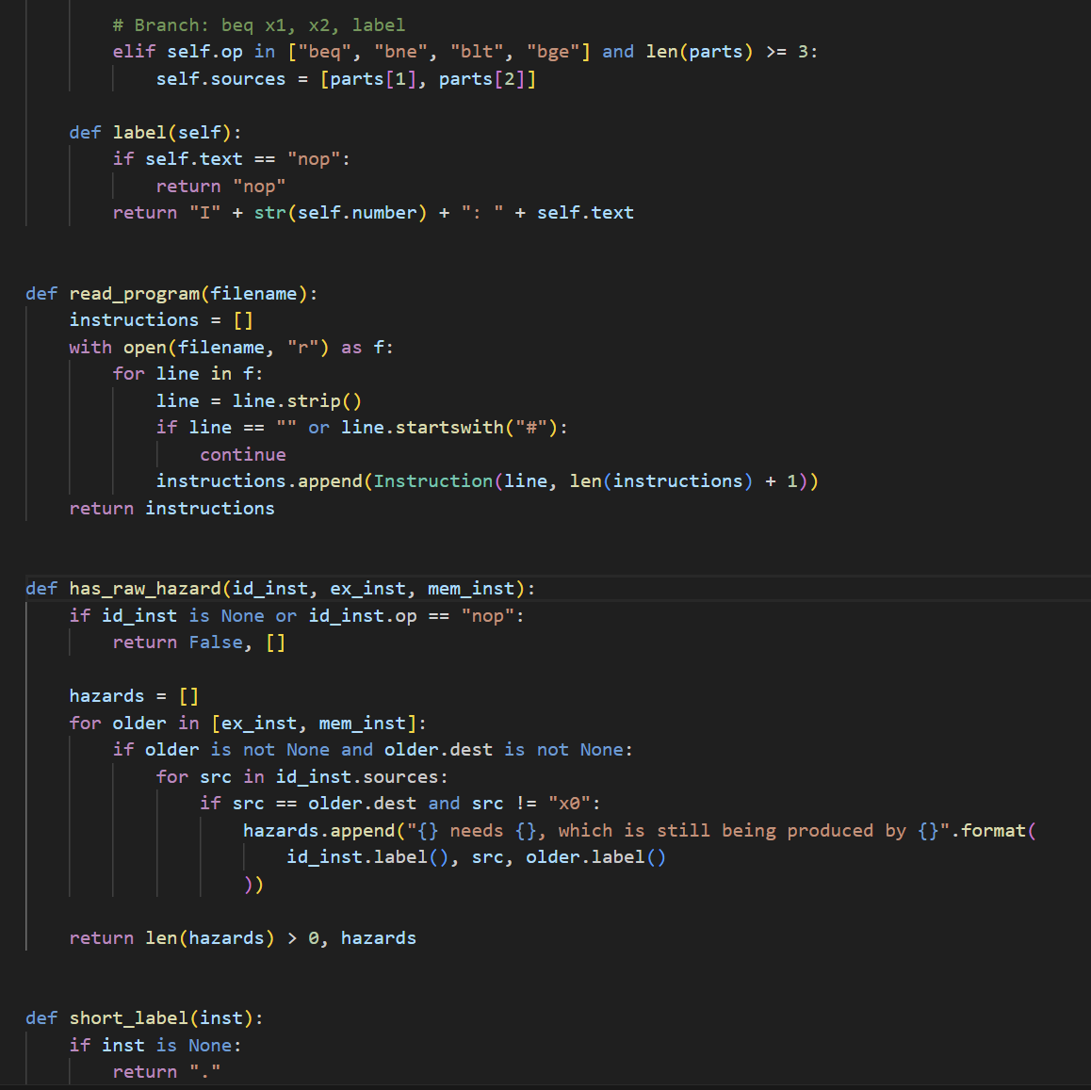
Key Code: Hazard Detection
Check EX & MEM stages
Any instruction still in the pipeline that hasn’t been written back can cause a hazard.
Source vs. Destination
If a source register of the new instruction matches a destination not yet written back, that’s a raw hazard
x0 is always 0
Writing x0 has no effect, so hazards involving it are always ignored

Slide 5
Results & Demo
HAZARD-FREE
BASIC HAZARDS
HEAVY HAZARDS
no_hazards.txt
basic_hazards.txt
heavy_hazards.txt
5
10
0
2.00
5
18
8
3.60
7
22
10
3.14
Instructions
Instructions
Instructions
Total Cycles
Total Cycles
Total Cycles
Stall Cycles
Stall Cycles
Stall Cycles
CPI
CPI
CPI

Slide 6
Observations & Takeaways
01
Dependent chains cascade stalls
02
Same instruction count ≠ same performance
When every instruction on the previous one (heavy_hazards), each pair adds 2 stall cycles. Additionally, those stalls compound across the whole program.
no_hazards and basic_hazards both have 5 instructions, yet take 10 vs. 18 cycles. That is an 80% difference caused by data dependencies.
03
04
Parsing edge cases matter
Forwarding would eliminate most stalls
Handling commas, parentheses (offset addressing), and comments correctly was essential for the simulator to work on real RISC-V assembly syntax.
All detected hazards are 1-2 cycle gaps. Data forwarding (bypassing) would resolve them without stalling. This is a key real-world CPU optimization.

